Slide 1

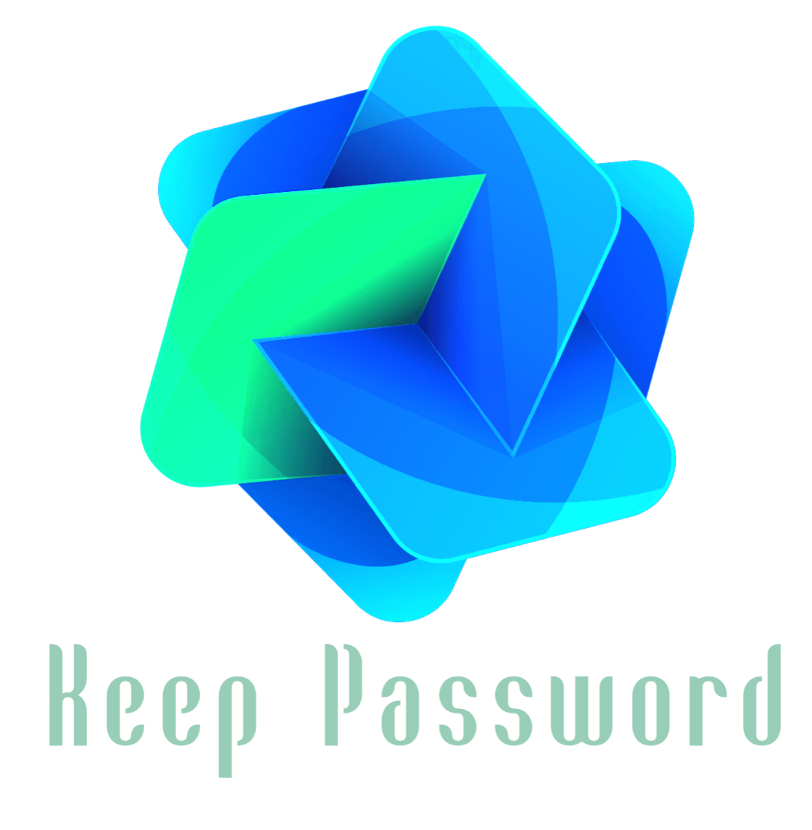

Develop an in-training application at Ministry of Communications and Information Technology
Name:
Tahani Abdulaziz Almanaa

Slide 2
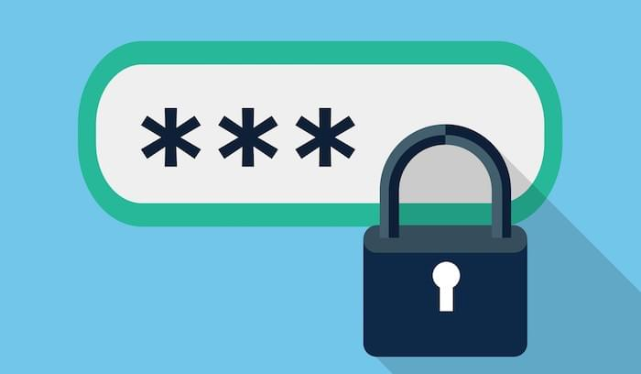

Sometimes you lose some of your passwords!
I decided to create an application using the Java language to save all your passwords.

Slide 3





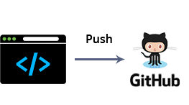
System Architecture and Scope:
I will work on the back-end of the application by using java language.
Java is a high-level, class-based, object-oriented programming language that is designed to have as few implementation dependencies as possible.
also, Java code can run on all platforms that support Java without the need for recompilation.
As of 2019, Java was one of the most popular programming languages in use according to GitHub.

Slide 4
Application advantages
It's free, you don't need to pay for the service.
Keep Password app can run on all platforms that support Java.
It's open-source, when finished it will be published on GitHub.
Easy to use.
More Security.
Add other languages for App.

Slide 5

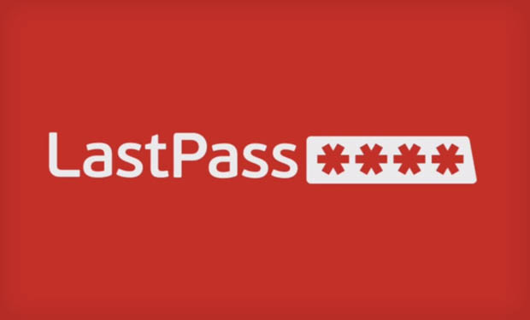
The applications similar :
Passwords are simple. They're either too easy to guess and using the same one everywhere is inviting hackers to take down all your accounts at once. Therefore, password managers are a good idea.
The Keep Password Application is distinguished from them by:
It Open-source and will publish on GitHub.
It will Free opposite for the service.
It will run on all platforms and desktop app.

Slide 6

The Goal Of Project :
Is self-development in building an application by using Java.

Slide 7
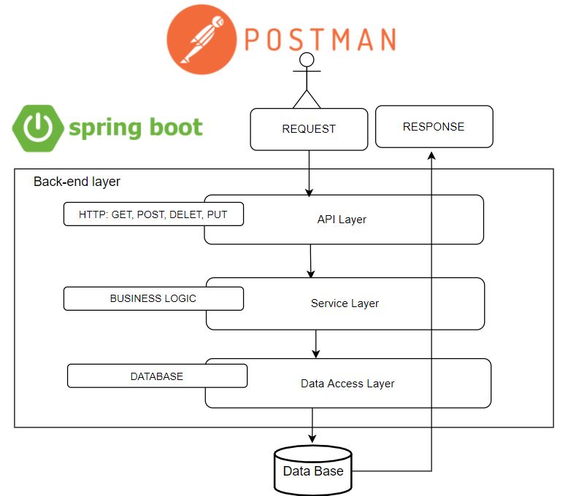
Back-end Layer diagram

Slide 8
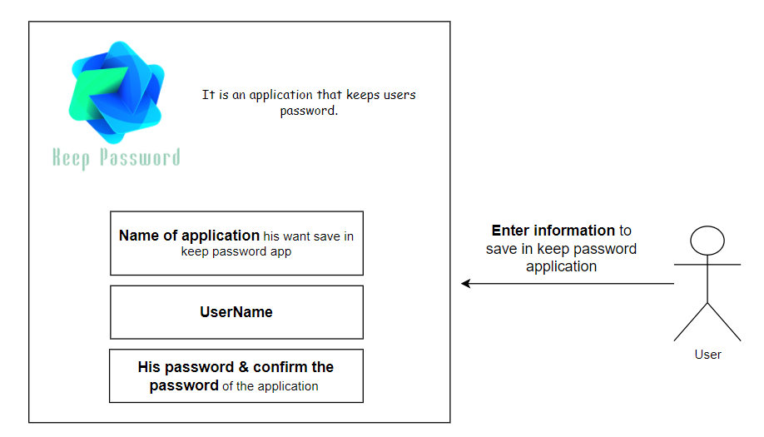
Use Case Diagram

Slide 9
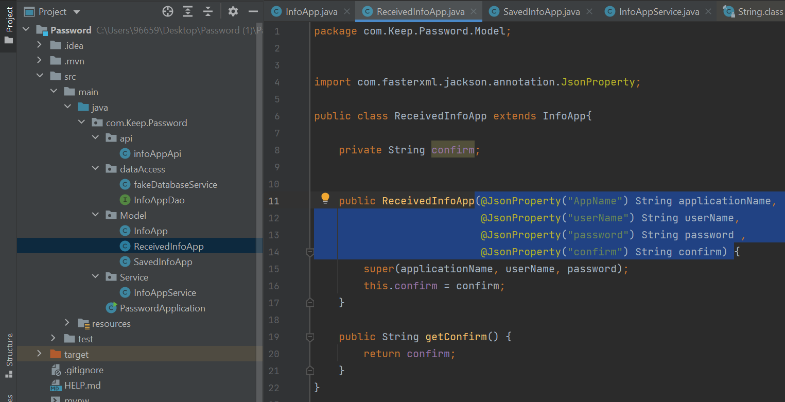
Some the screenshot of code and run
The information entered by the user is sent to the InfoAppService class to verify.

Slide 10
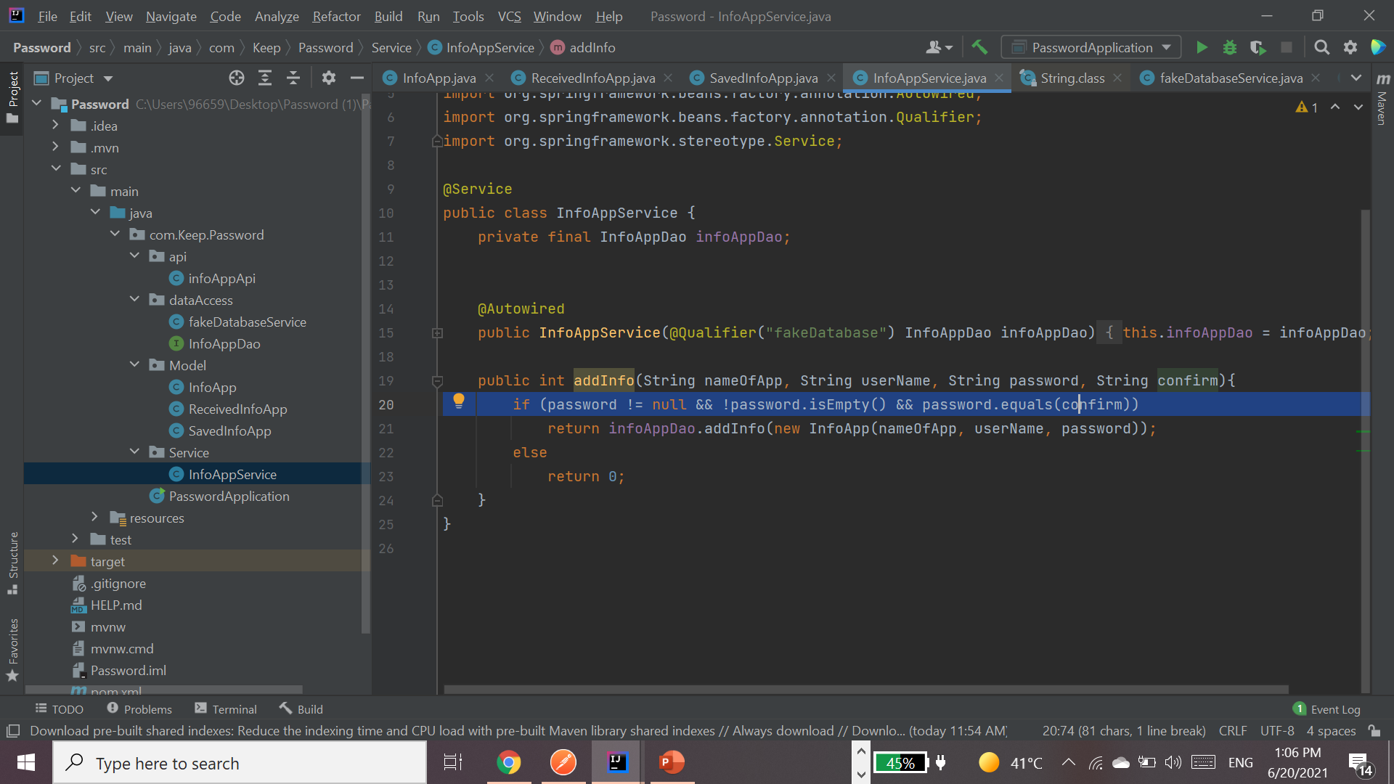
This condition
verifies that the password entry and confirmation match, in which case they are saved to the DB.

Slide 11
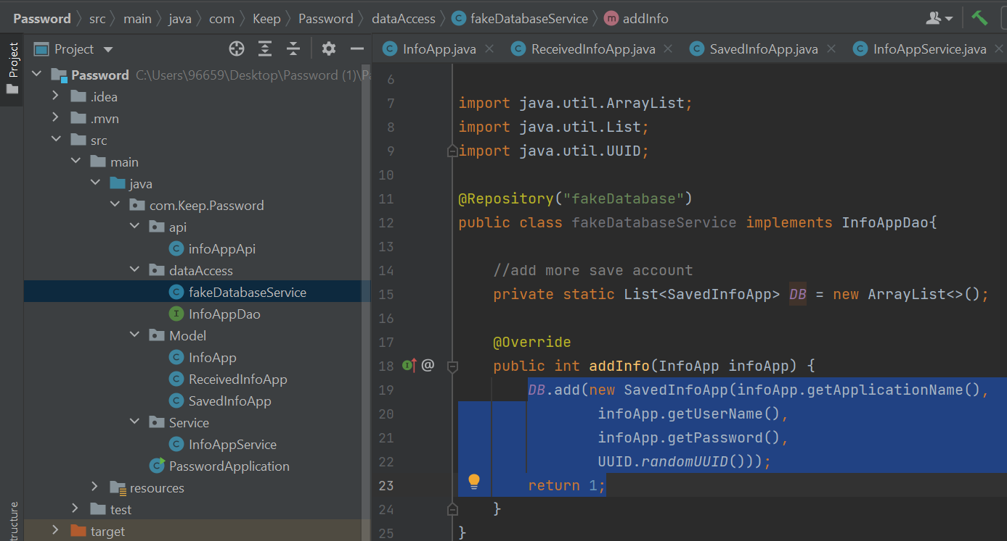
The information is added to the DB, returns 1 and means that the operation was successful.
Each user has a unique number that is dealt with in the database in terms of adding, updating, deleting ... etc.

Slide 12
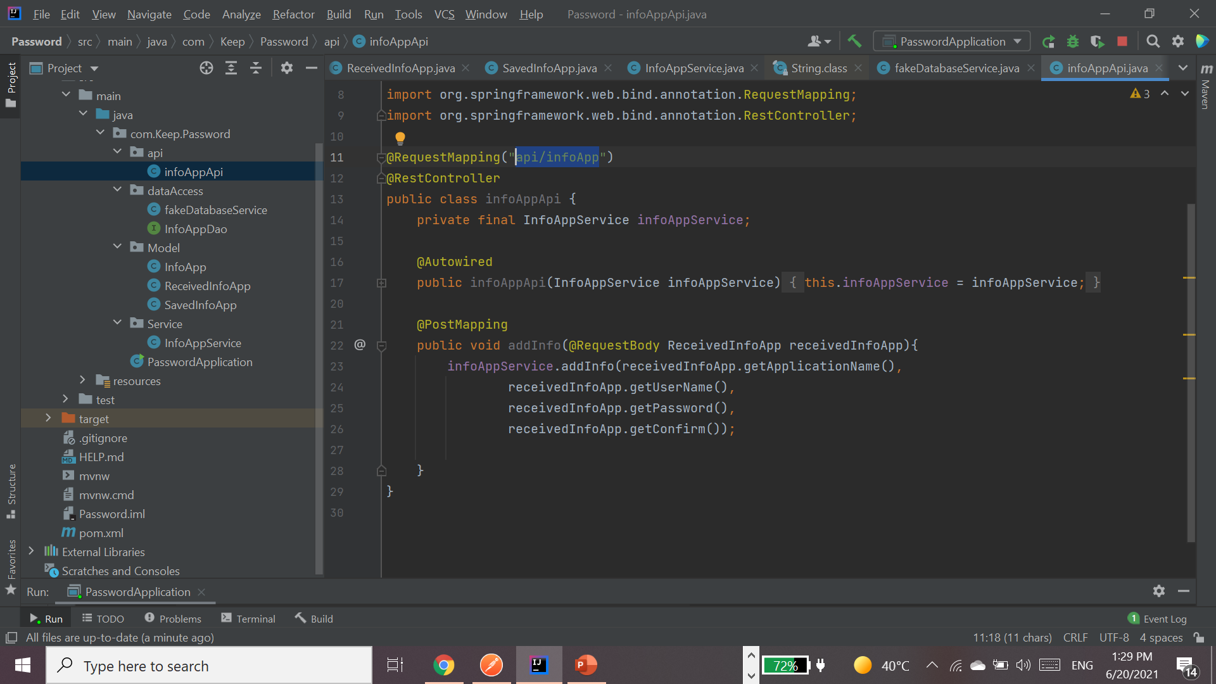
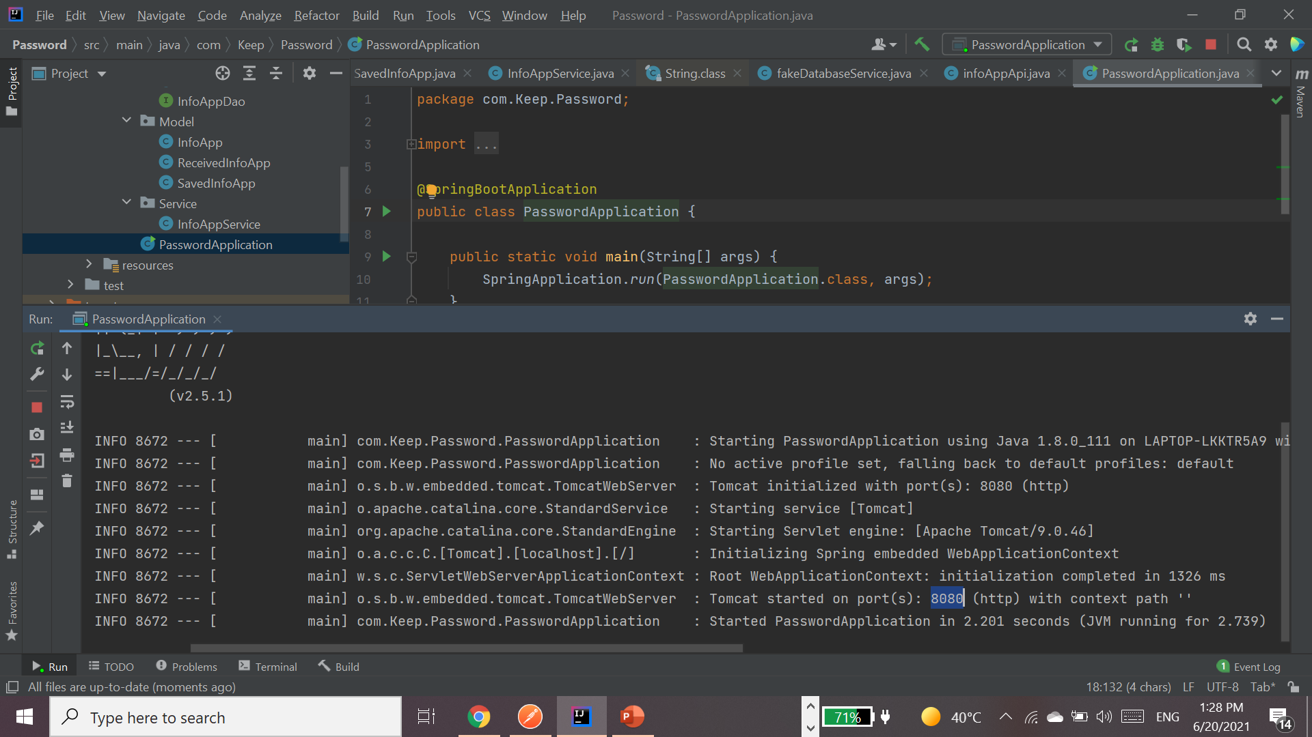
Run ..
The port and path are added to the postman address bar.

Slide 13
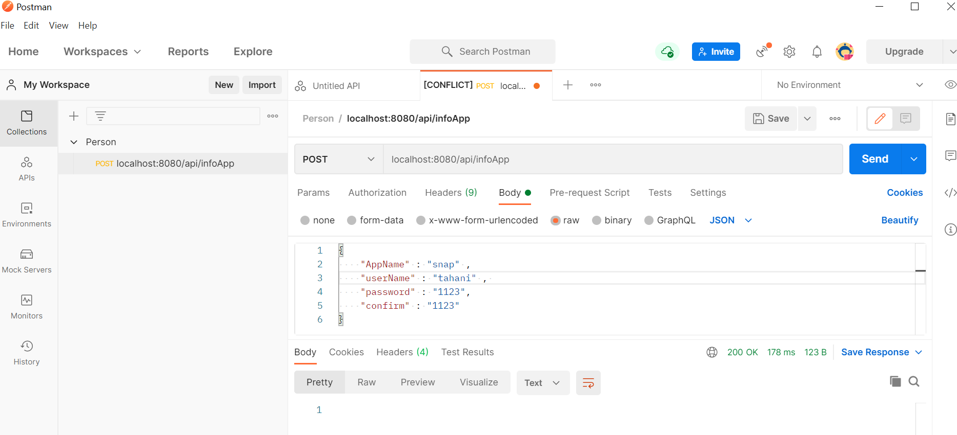
“1- Add in the DB”
In Case True
Was return 1,
that the information entered complies with the conditions.

Slide 14
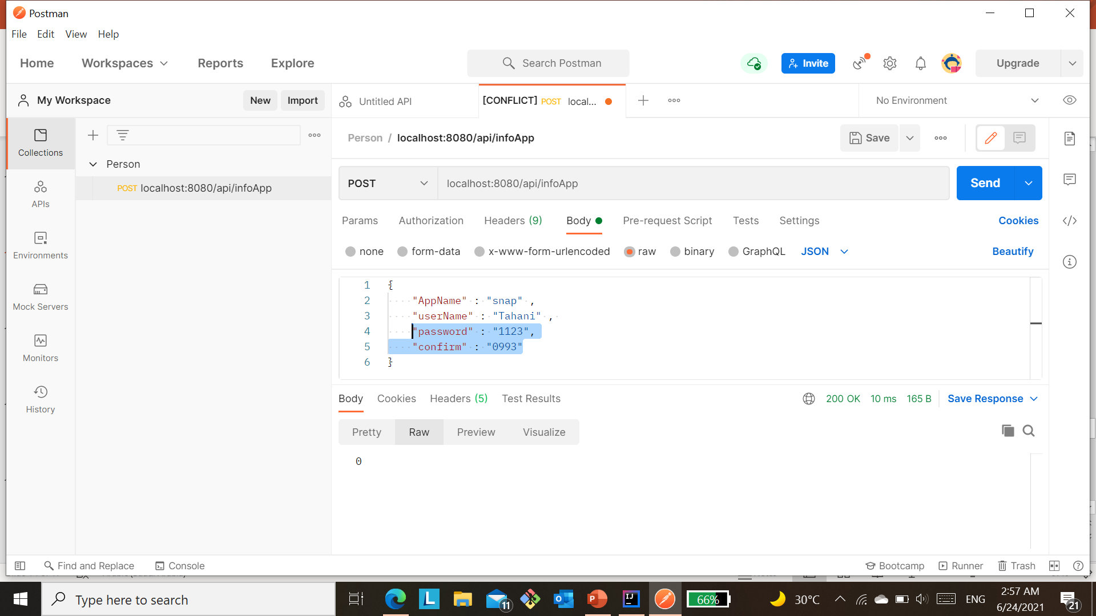

0 is returned, that the information entered does not comply with the conditions.
In Case False:

Slide 15
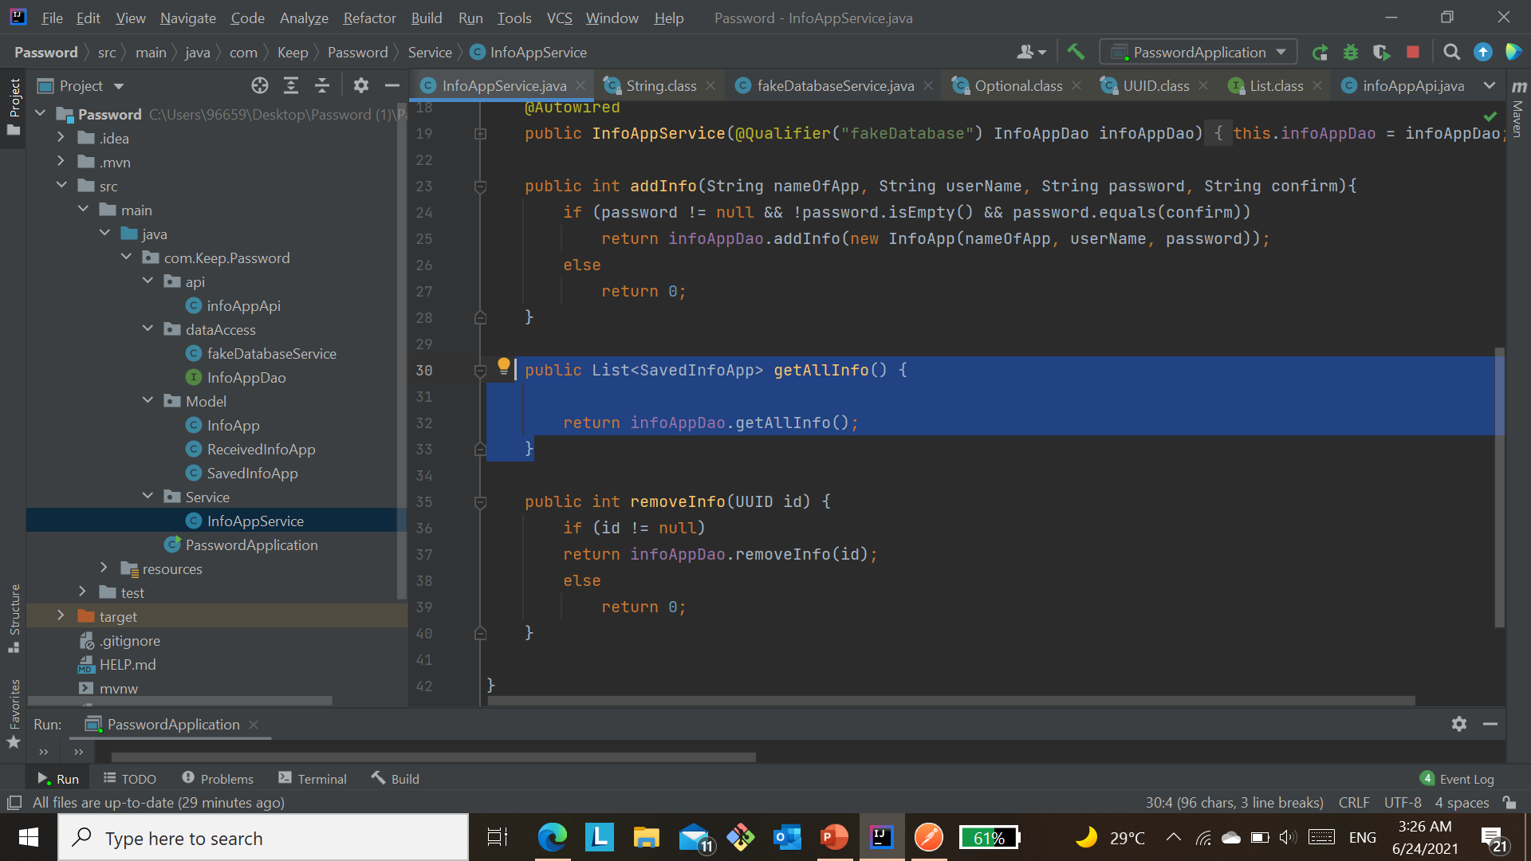
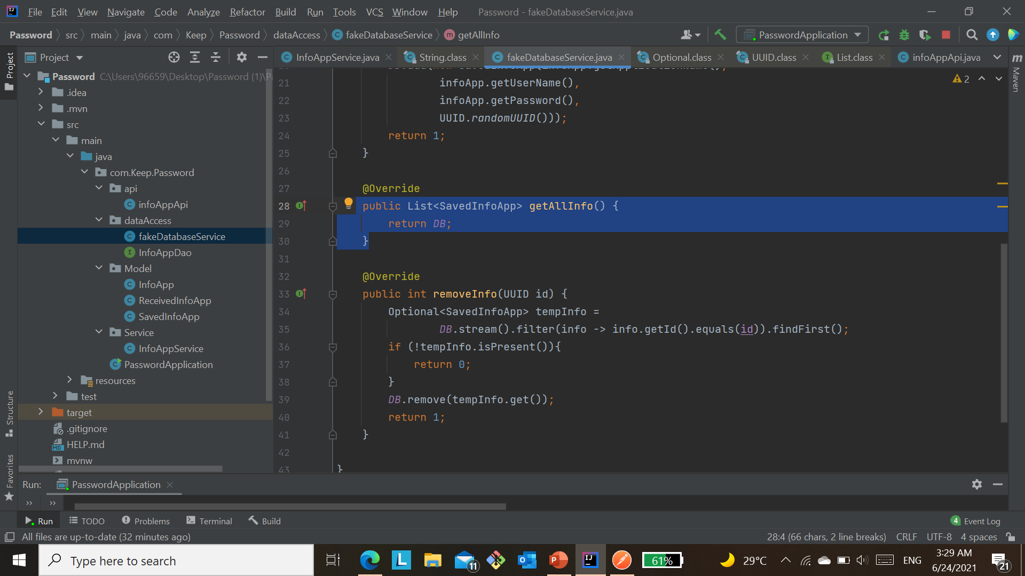
This function return all users in the database.

Slide 16
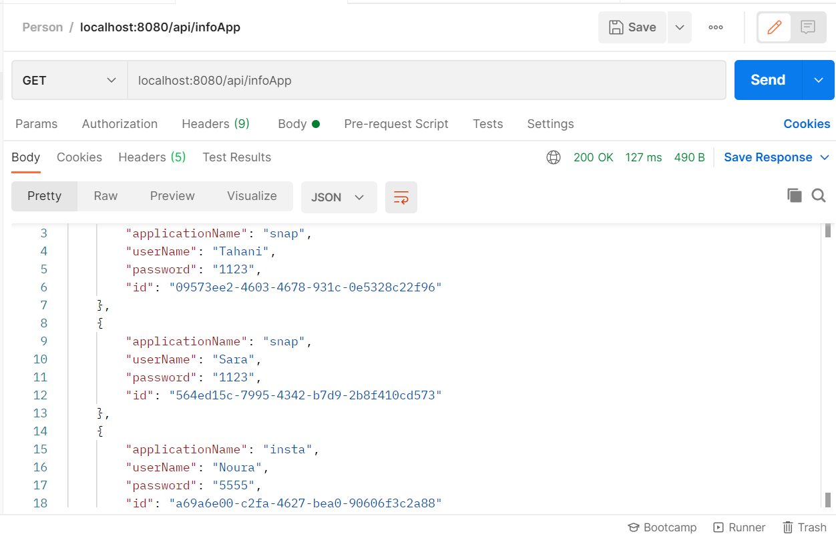
2- Retrieve all users from the database.

Slide 17
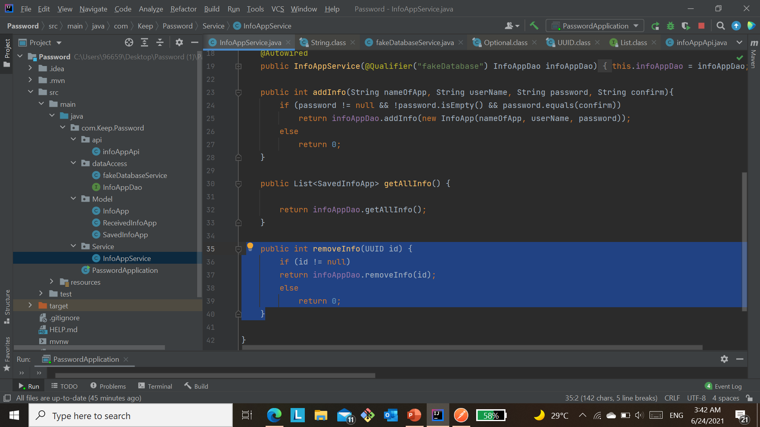
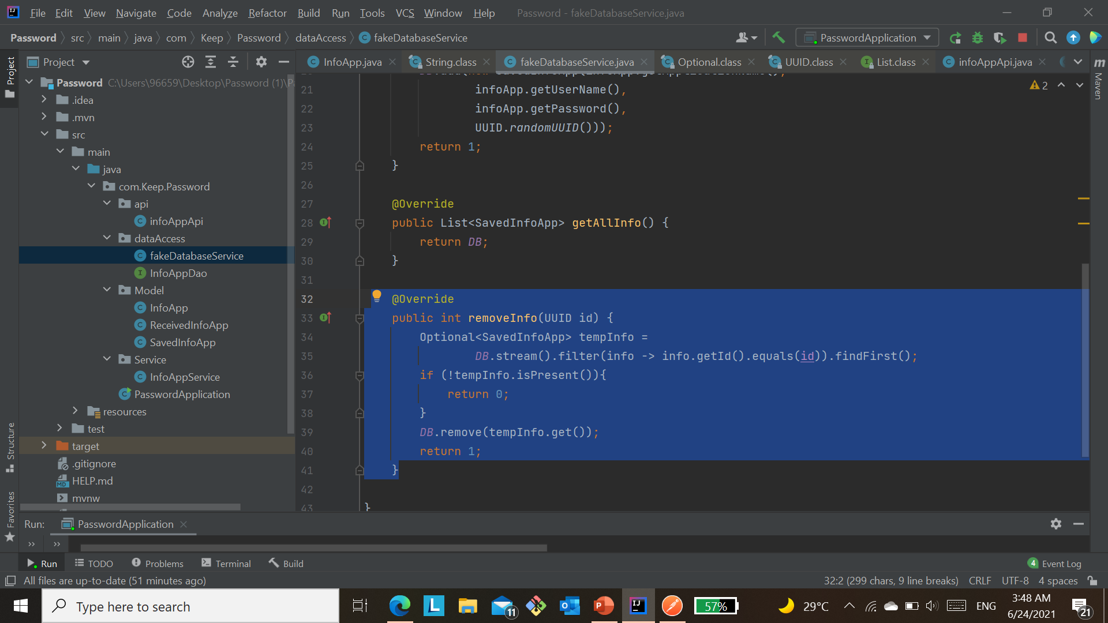
This function is used to delete a specific user by ID from the database. In the case that the ID is not null, it is sent to the deletion removeInfo method. Else, it returns with zero.
3- Delete by ID.
When the id in the parameter matches the first identifier from the database, in this case, it is deleted and the number 1 returns, indicating that the deletion process has been completed.
But if it doesn't find the ID, it returns zero.

Slide 18
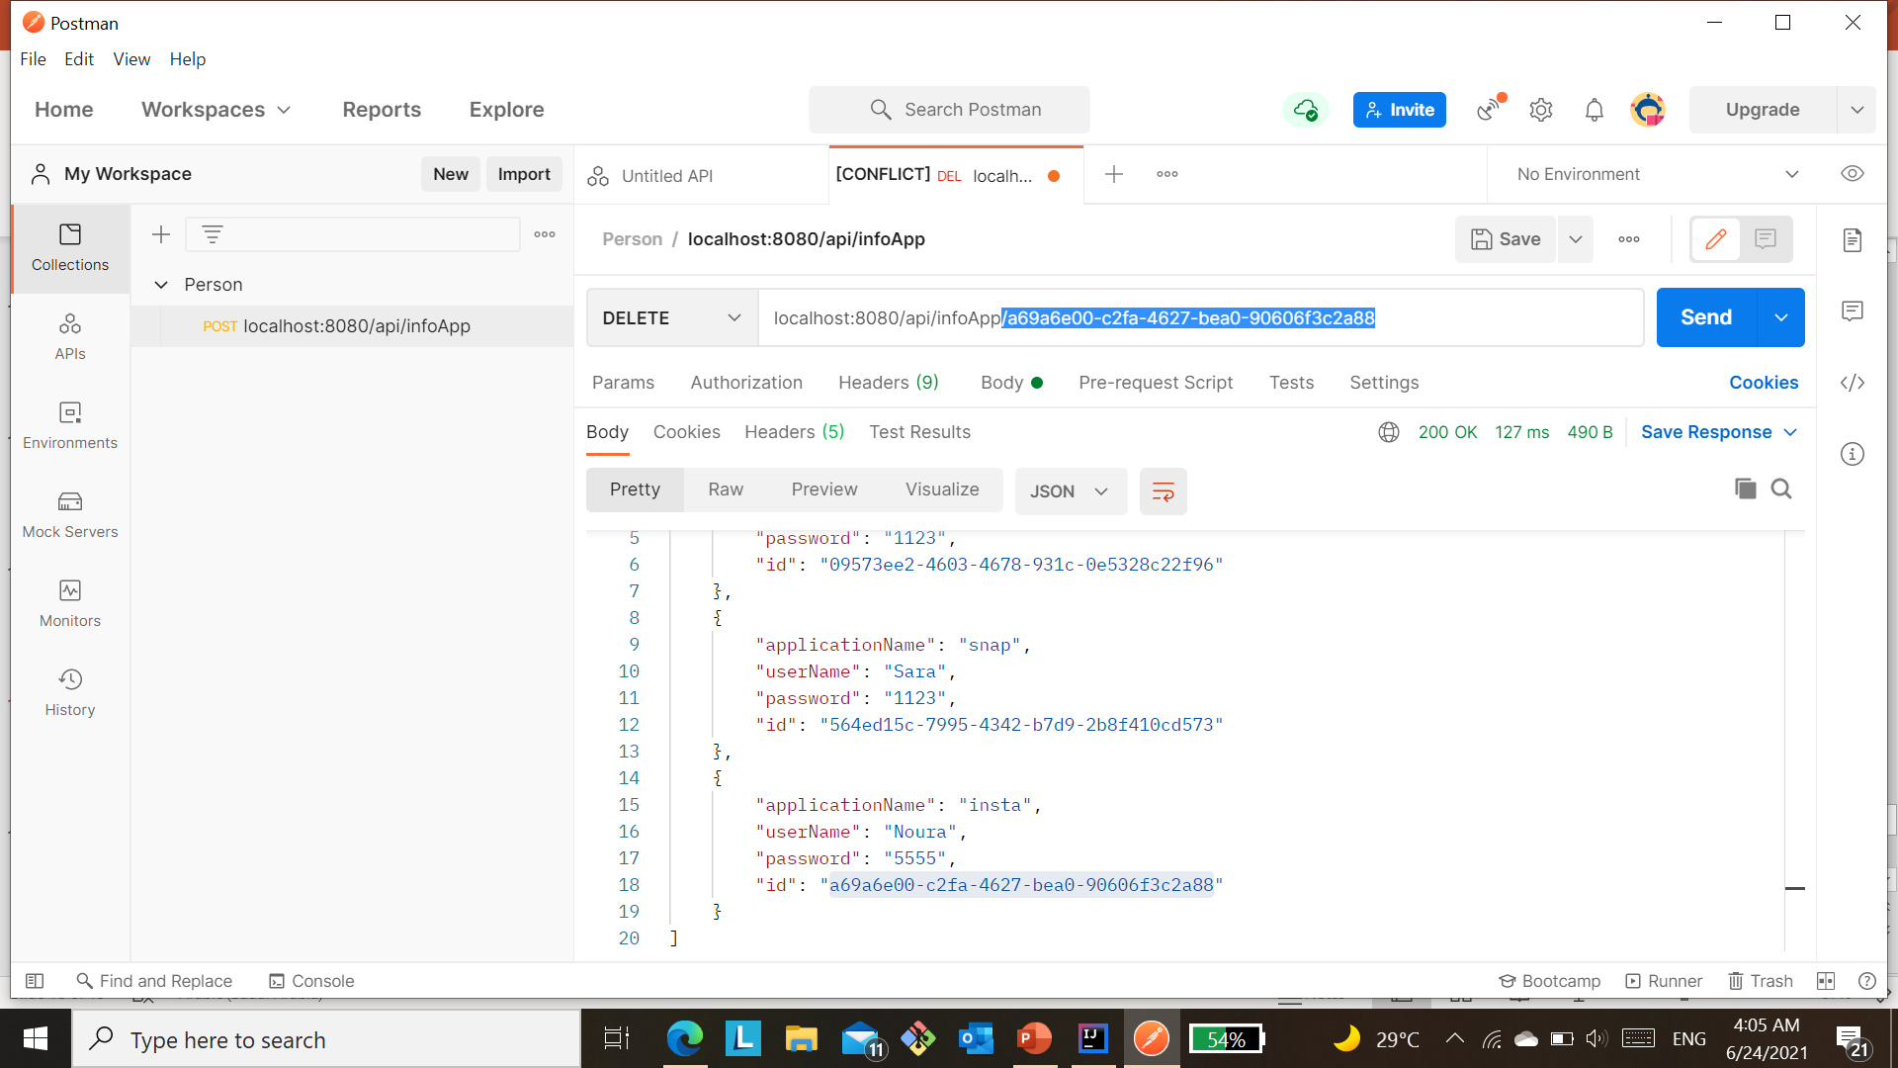
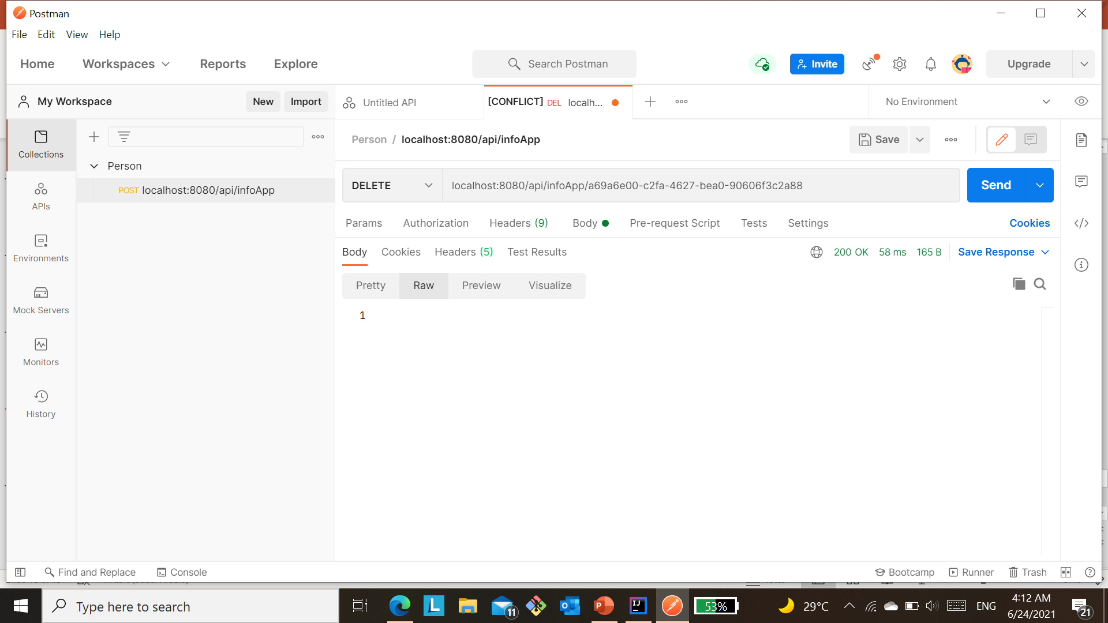
#3
#2
#4
#1
The ID to be deleted is selected, placed in a tape, then delete, and thus send.
Is returned 1 if the ID is present and has been deleted

Slide 19
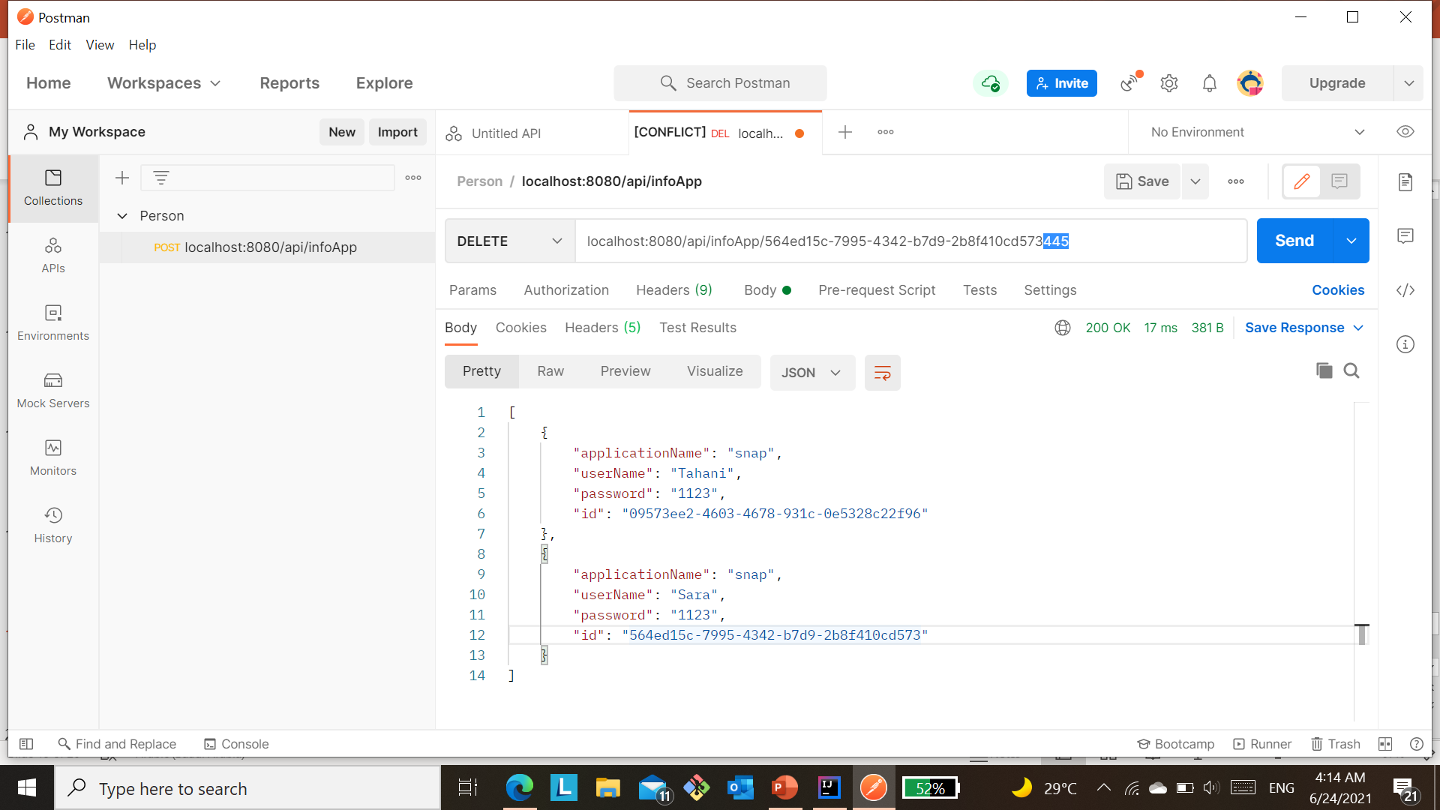

If the matching ID is not found, will be returned 0.
not match

Slide 20
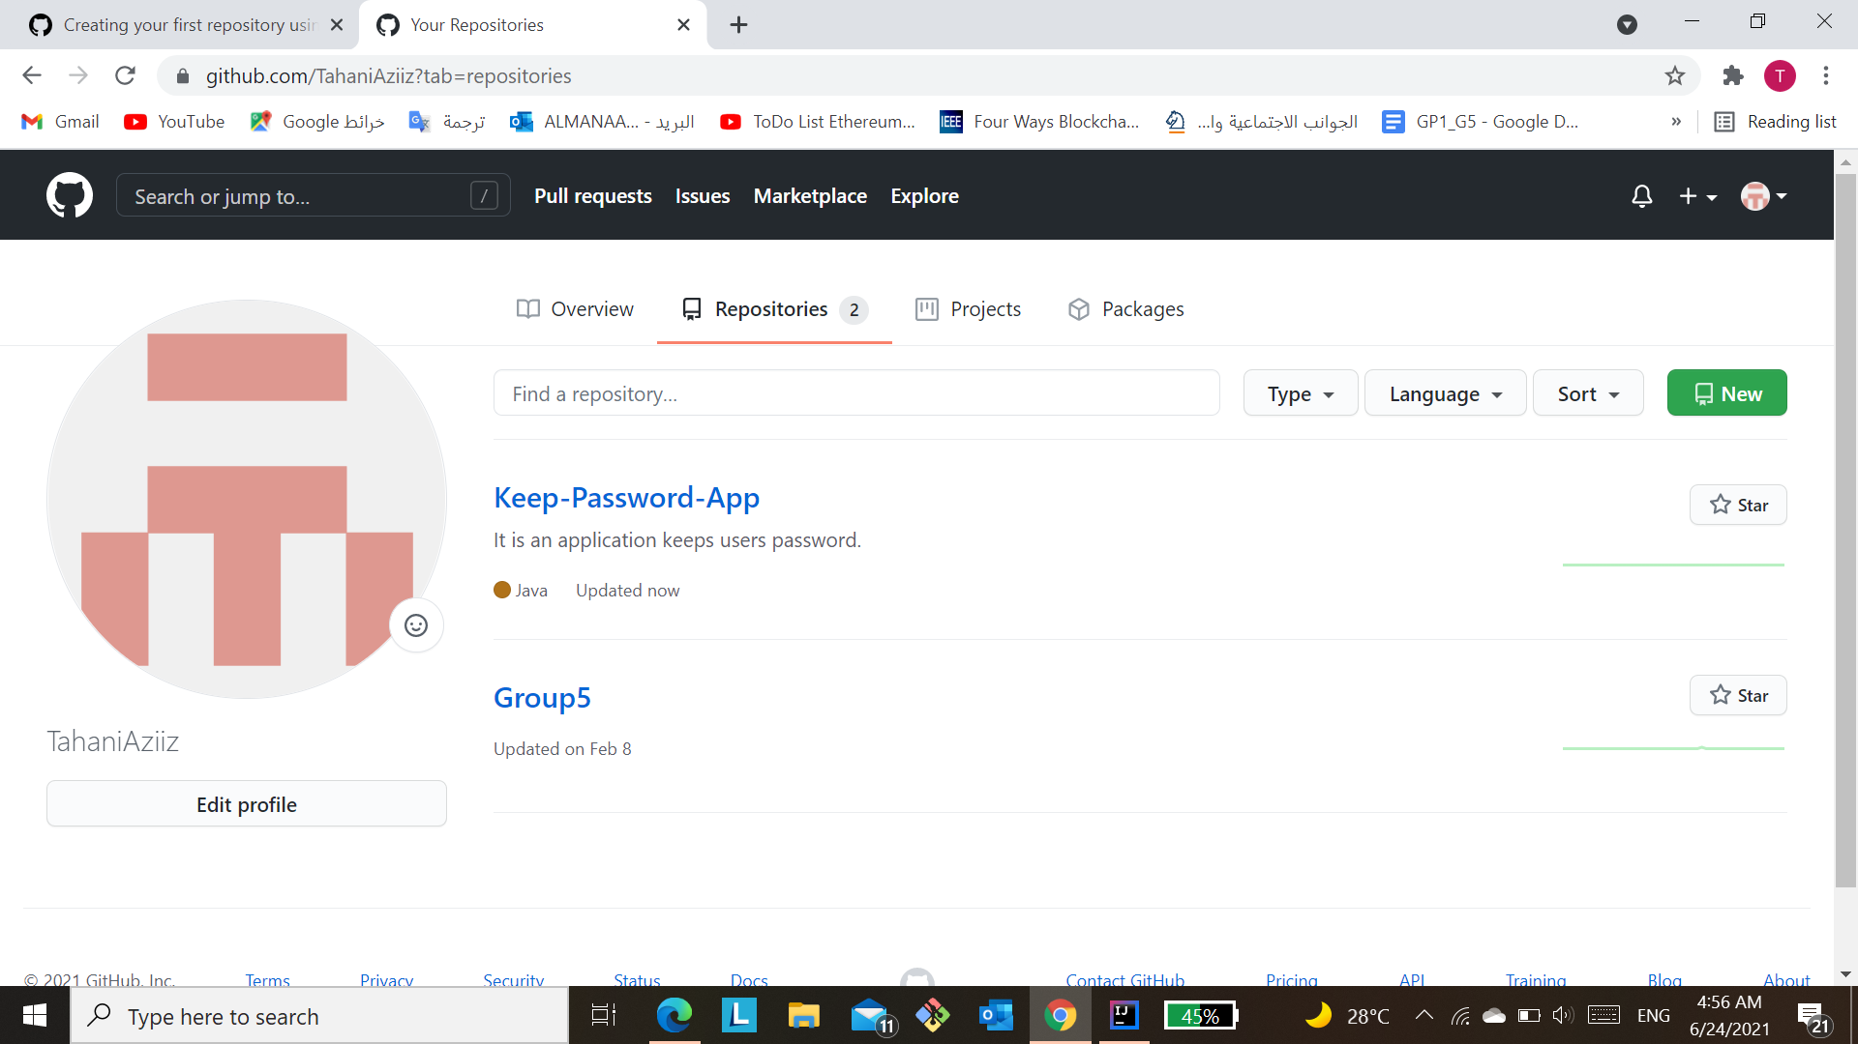

Publish The First Version:
The first version was published in GitHub, that contains the function of "add, get, and remove".
Link GitHub:
https://github.com/TahaniAziiz/Keep-Password-App

Slide 21

TimeLine
The implementation of the application may take 4-6 weeks from start 9 June to 8 July.

